Slide 1
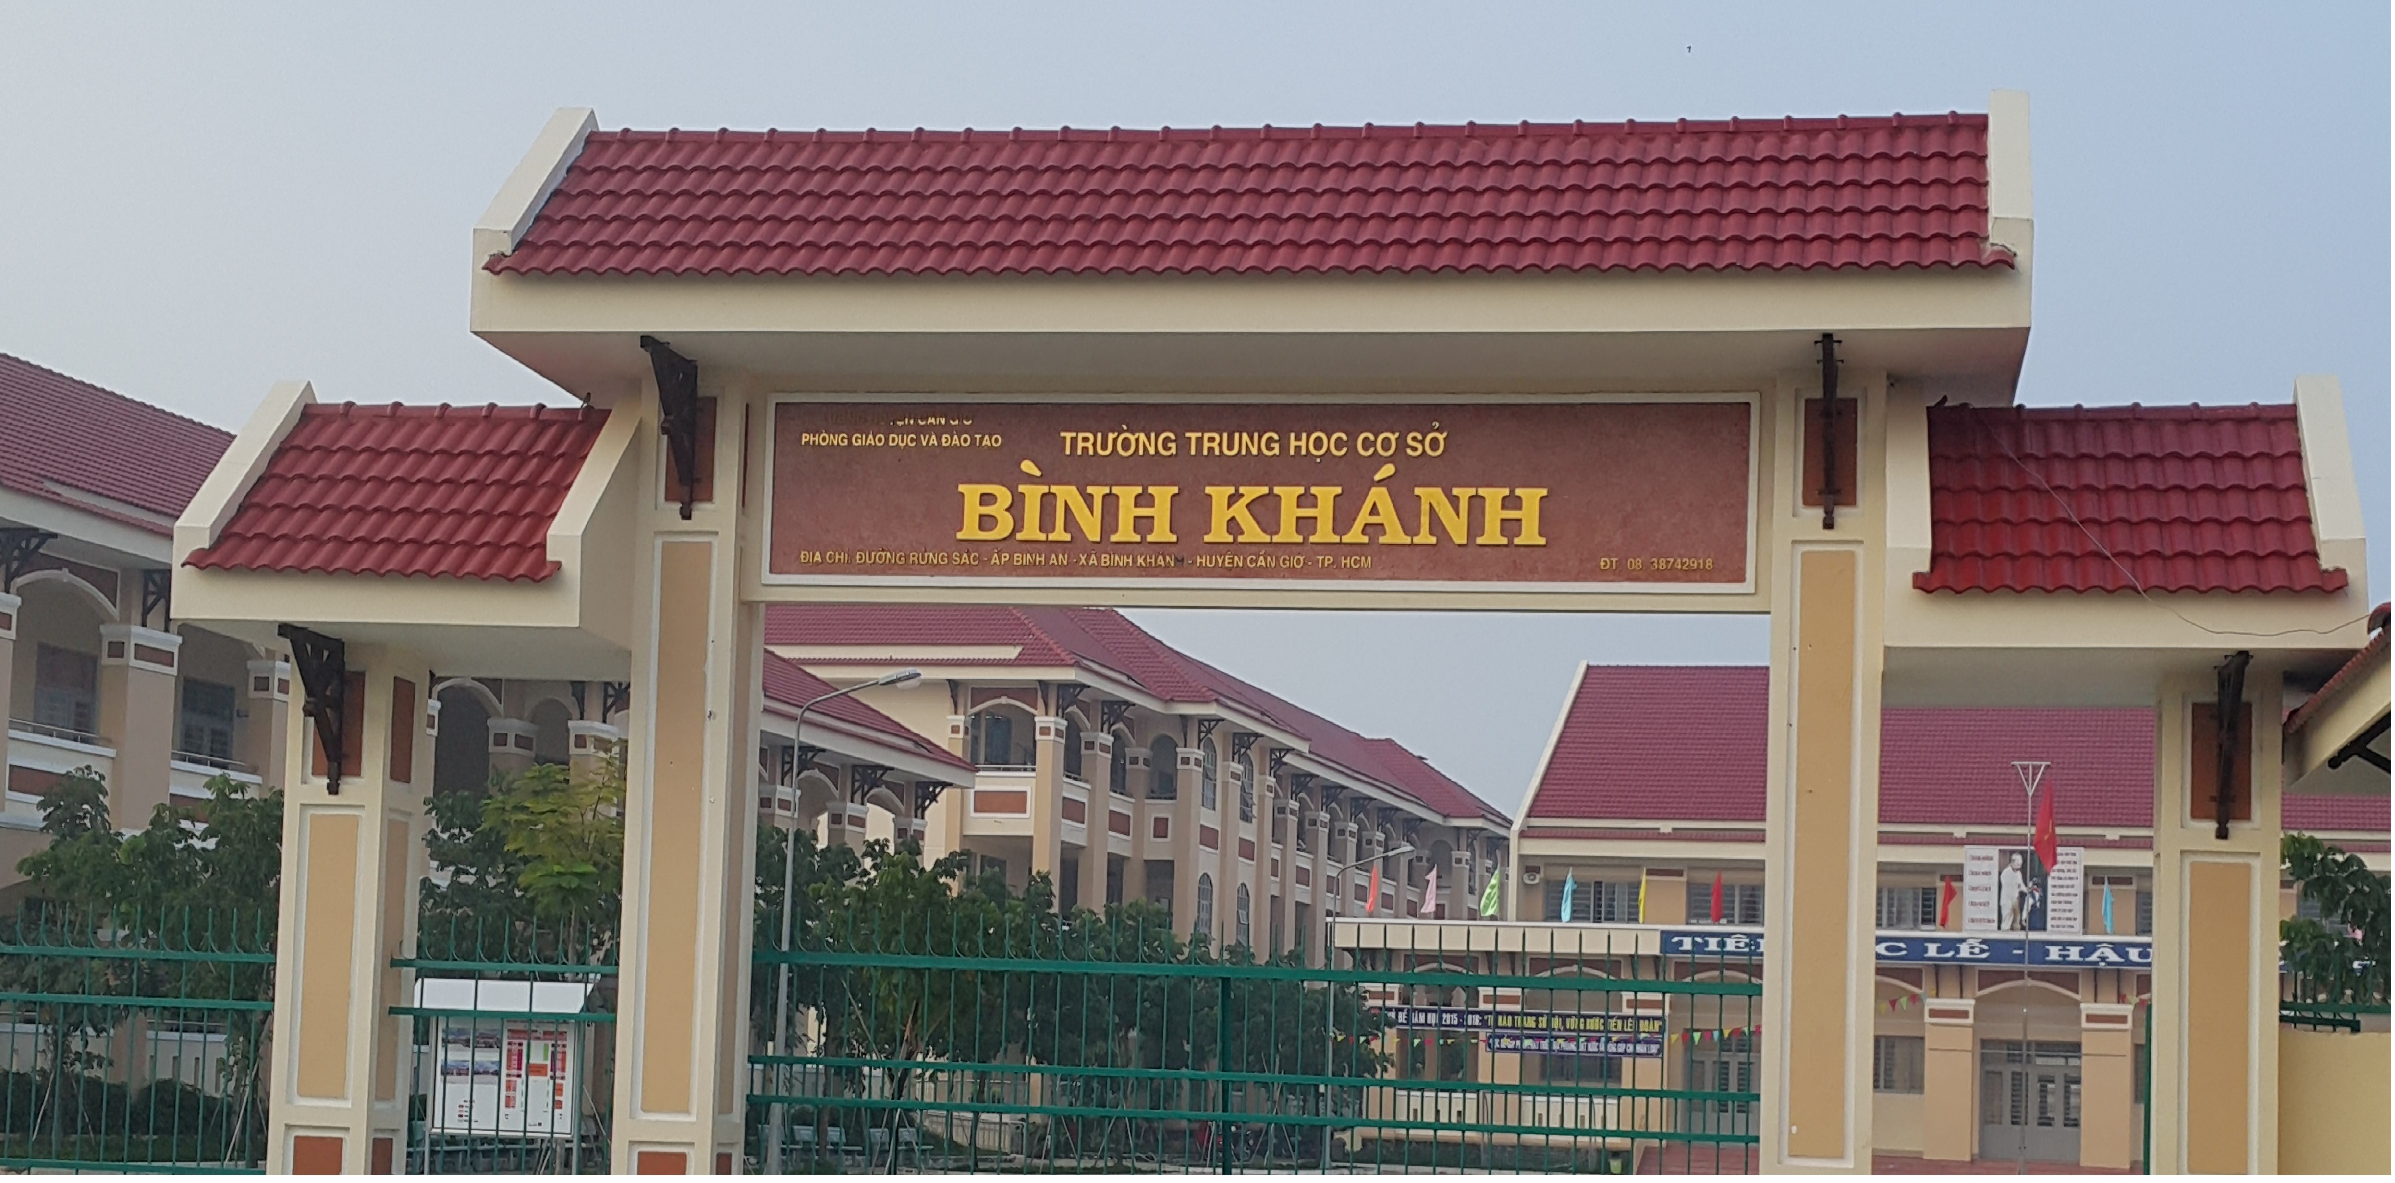
ENGLISH 8
BINH KHANH SECONDARY SCHOOL

Slide 2

PLAY A GAME
Look, remember
and then write them in English

Slide 3

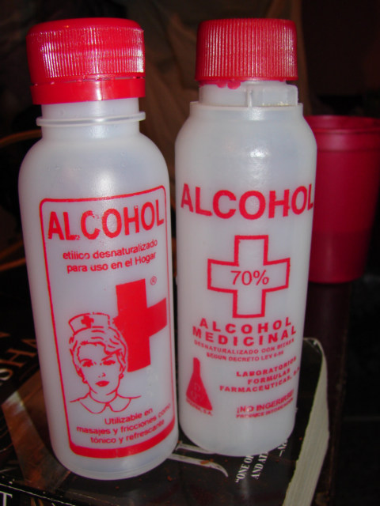
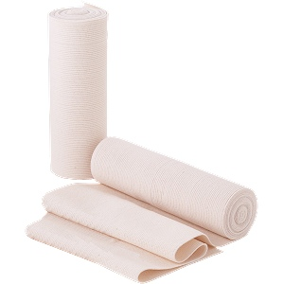
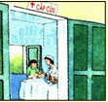



7
6
5
4
1
2
9
8
3
10
Time :
Time over

Slide 4


15
14
13
12
11
10
9
8
6
5
4
3
2
1
0
16
17
18
19
20
7

Slide 5
Emergency room
Bandage
Alcohol
Medicated oil
Ice
Ambulance

Slide 6
English 8
Unit9; A First-aid Course
Period 56, Speak + Listen
A. Speak

Slide 7
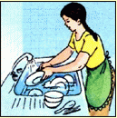
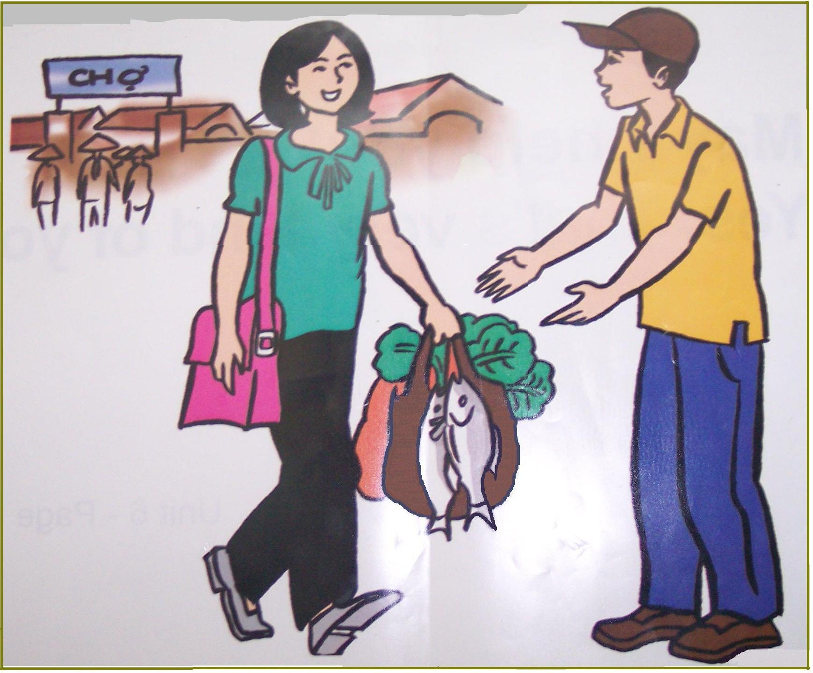

Pre speaking
You want me to wash dishes . How can you say ?
Can/could you wash these dishes ,please ?
You want to help me . How can you say ?
Shall I help you ?
You don’t do your homework .
How can you say to your teacher ?
I promise I’ll do my homework next time.

Slide 8
Unit 9 A first-Aid course
Lesson 2. Speak & Listen
Make and respond to requests, offers and promises
Requests | Offers | Promises
Can/Could You ………? Will/ would you……….? | Would you like…….....? What can I get for you? Shall I…………………? Will/ Won’t you have…? Can I get you…………? | I will…. I promise. I promise I’ll…. I promise I won’t.. I promise to……...
Responses
Sure/ OK All right. I’m sorry, I can’t. I’m afraid not. | Yes, please. That would be nice. No, thank you. | I hope so. Good. I’m glad. Don’t forget.

Slide 9
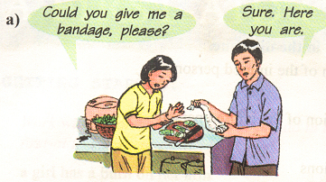
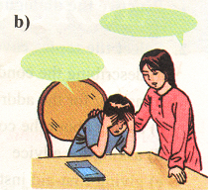
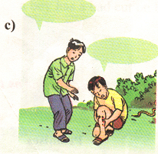
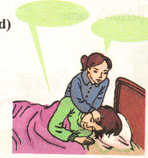
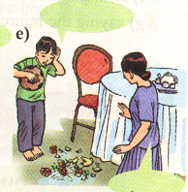
What’s the matter with these children?
The girl has a burn on her hand.
The boy has a headache.
The boy has a snake bite.
The boy has a fever.
The boy has just broken a vase.

Slide 10

Picking apples
Team A
Team b
1
5
4
3
6
2

Slide 11
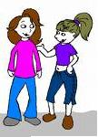

The boy has just broken a vase
Boy :I promise I won’t play soccer in the house again .
Mother : I hope so / Don’t forget.

Slide 12
The boy has a fever.
A .Would you like some medicine ?
B. That would be nice ./ No, thanks.

Slide 13
The boy has a headache.
Yes, please . / No, I’m fine.
Shall I get you some medicine ?

Slide 14









Lucky Number!

Slide 15
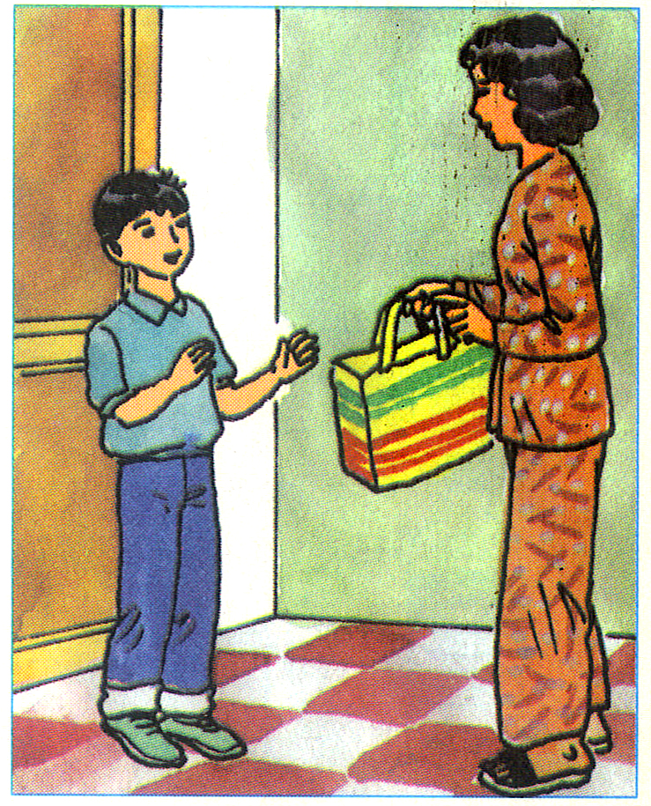
Can you help me ?
Yes , please .

Slide 16
Sure!
Can you get me some bandage ?
The boy has a snake bite.

Slide 17
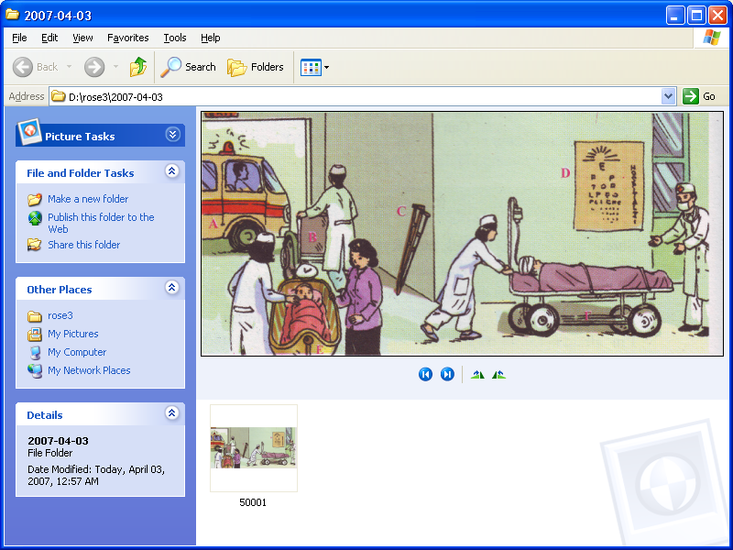
Emergency Room
Look at the picture and answer the questions
Who are they ?
Where are they ?

Slide 18


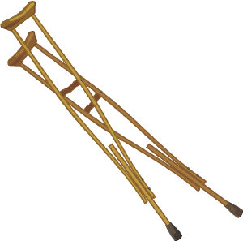

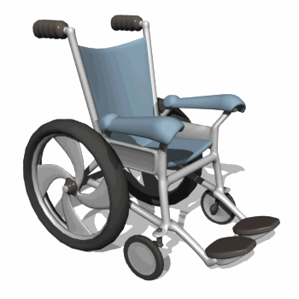
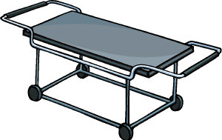
Matching the pictures with the words in the box
New words
Ambulance
Crutches
Scale
stretcher
wheelchair
eye chart
Ambulance
Crutch(es)
Scale
stretcher
wheelchair
eye chart

Slide 19
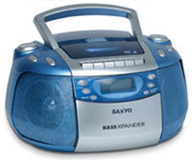
English 8
Unit9; A First-aid Course
Period 56, Speak + Listen
A. Listen

Slide 20
Guess from context: What actions ?
Look at the picture and write out all the verbs describing the actions of the people in it .
Drive
wheel
Push
Weigh

Slide 21
Ambulance Crutches
Scale stretcher wheelchair eye chart
Match the letter A,B,C,D or F to the correct words in the box ,
Then put them in the correct order as you hear.
A
C
E
F
B
D

Slide 22

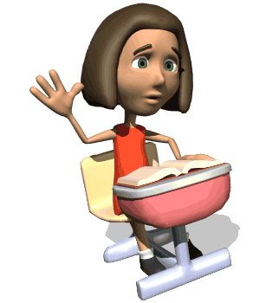
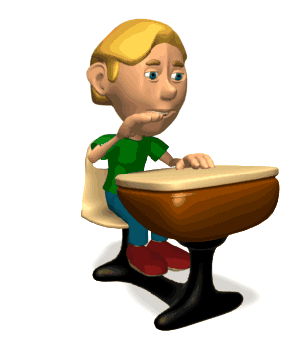
You guess On tape
Ambulance ………… …………
Wheelchair ………… …………
Crutches ………… …………
Eye chart ………… …………
Scale ………… …………
Stretcher ………… …………
3
2
6
4
5
1

Slide 23

True or False Statements
1/ A doctor is wheeling a patients into the emergency room.
__________________________________________
2/ The patient’s head is bandaged.
________________________________
3/ A nurse is pushing a wheelchair with a patient sitting on it.
__________________________________________________
4/ The eye chart consists 28 letters ranging in the different size.
_________________________________________________
5/ The baby’s mother is trying to stop the nurse from
weighing her baby.
_________________________________________________
- False (a paramedic not a doctor)
-True
- False ( empty wheelchair not a patient sitting on it)
- True
- False (stop her baby from crying)

Slide 24
Write :
5 sentences to describe the picture.
This is the emergency room in a large hospital .
………………………………………………………….
…………………………………………………………….
…………………………………………………………….
…………………………………………………………….
…………………………………………………………….
…………………………………………………………….

Slide 25
Homework.
- Exercise in workbook unit 9
- Learn by heart new words
- Prepare ,Unit 9 , READ

